Slide 1
iStart Departmental User Guide Presented by: The Office of Global Human Resources and The Office of International Education
Processing Foreign National Employees, Scholars & Visitors in iStart
January 2014

Slide 2
Processing Foreign National Employees, Scholars & Visitors in iStart
All foreign national employees, scholars and visitors must be processed in iStart by the hiring or host department.
Before a foreign national can begin working, conducting research, etc., Global HR or ISSS must approve the appropriate iStart e-forms.

Slide 3
Processing Foreign National Employees, Scholars & Visitors in iStart
Each nonimmigrant and immigrant section contains 4 slides
General information about the visa status
Overview of the process with the various entities and systems
Details of the process per person
iStart process; the required e-forms and documentation
General Information
Process Overview
Process Details & Timeline
iStart E-forms & Required Documents

Slide 4
Processing Foreign National Employees, Scholars & Visitors in iStart
After completing this tutorial, you should be able to do the following:
Add a new person to iStart
Review your open cases
Identify appropriate status options for the employee, scholar or visitor
Initiate requests in iStart
Identify which statuses are processed by Global Human Resources
Identify which statuses are processed by ISSS

Slide 5
Definitions & Terms
Nonimmigrant Visa Status
Intent to visit the U.S. for a temporary period. Admission granted for a specific period of stay and to participate in a specified activity
travel.state.gov/visa/temp/types/types_1286.html
Immigrant Visa Status
Intent to reside in the U.S. permanently. Admission granted with no specific period of stay no restrictions on activity
http://travel.state.gov/visa/visa_4354.html

Slide 6
Federal Agency Overview
Department of Labor
Department of Homeland Security
Department of State
Employment & Training Administration
Foreign Labor Certification
National Prevailing Wage Center
Customs & Border Protection
Citizenship & Immigration Services
Immigration & Customs Enforcement
SEVIS
Consular Affairs
Educational and Cultural Affairs

Slide 7
iStart Departmental User Access
Requesting Departmental Services Access
After viewing this tutorial, submit a web form at www.oie.gatech.edu/istart
The screen shots demonstrate the following:
How to log in with department access
Accessing client cases
Visual of grouped e-forms look like and what pending for review means
Understanding client access vs. 2nd approver
Notes:
Edit

Slide 8
Log in with Department Access
Department access

Slide 9
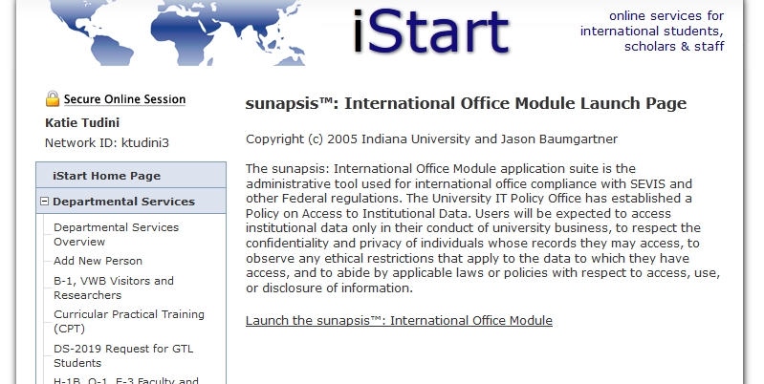
Viewing All Client Records

Slide 10
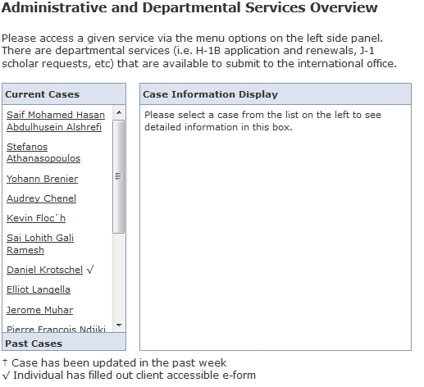
View Specific Cases

Slide 11
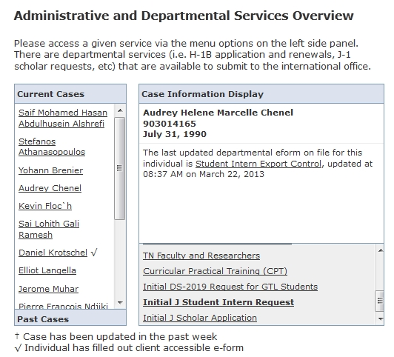
Case Information Display
To view the status of the Request for this case click on the specific request title

Slide 12
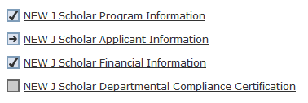
Reviewing A Pending Grouped E-form-
The section is incomplete and needs action by the Department Administrator to either complete the section or initiate the second approver e-form to the scholar
The section is complete and no further action is needed
The section is not yet available until all other sections of the request have been completed
The section is pending review by OIE
The section has been sent to PI or scholar as a second approver to complete. Upon completion of the 2nd approver section, it will be complete and a check-box will be visible.
The icons above are what you will see when completing the J Scholar Initial DS-2019 Request. Below is a brief description of other icons you may see as an iStart Departmental Services user.
Optional- Submission of this section is not required
Draft- The section has been saved to draft status by Department Administrator
Submit Another- Alows for multiple submissions of the same e-form. Use ONLY for NEW requests
Follow-Up Required- The section has been saved to follow-up status by OIE and requires action by the initiator of the request
Denied- E-form has been denied by OIE. A NEW request must be submitted.

Slide 13
Client Access vs. 2nd Approver
Client access allows the Hiring Manager to send an entire E-form to the client for their completion.
2nd Approver allows a hiring manager to designate a second party (applicant, PI, OLA etc.) to complete a portion of the form (Placement Plan, Language Proficiency, Export Control, etc.).

Slide 14
Nonimmigrant Status Options

Slide 15
B-1 Business Visitor or Visa Waiver Business
Primary Purpose
Consult, Attend Meeting
No Employment
Permissible Activities
B-1 visa holders or Visa Waiver Business (VWB) may participate in scientific, professional or business conventions/ conferences, or undertake independent research.
Restrictions
B-1 visa holders are not permitted to accept full-time, part-time or temporary teaching or research positions.
Honorariums permitted if the activity lasts no more than 9 days and the individual has not accepted payment from more than 5 institutions in the previous 6 months.
Funding Source
Subsistence allowance (per diem) or reimbursement for travel and living expenses permitted.
Honorariums permitted but limited.
Duration
B-1: 6 month maximum, possible extension
VWB: 90 day maximum
Cost
The individual is responsible for any costs incurred
Administrative Office
Global HR

Slide 16
B-1/VWB: Process Overview
Georgia Tech
Department of State
Consular Affairs: B-1/B-2 Visa
Department of Homeland Security
Customs and Border Protection: B-1 or VWB at port of entry
iStart: Department / Visitor / Global HR

Slide 17
B-1/VWB: Process Details & Timeline
PI and/or Visitor
Determine program details and dates
Request must be submitted at least 1 month before planned start date
HR Rep
Request GT ID from Banner
Complete required e-forms
PI & Legal Affairs
Visitor
Complete required e-forms in iStart
Review all electronic forms submitted by department and visitor
Consular Affairs
Visitor makes visa appointment
Customs and Border Protection
Stamp visitors passport with either B-1 or VWB
If the visitor enters as a tourist (B-2 or VWT), they must have it changed
Wait times vary and are unpredictable
Visitor
Complete iStart arrival information within 48 hours of arrival
Global HR
Complete export review process

Slide 18
B-1/VWB: iStart E-forms & Required Documents
HR Rep
Departmental Contact
Visitor
Pre-Arrival
B-1, VWB Visitor/Researcher Information
CV
Passport
Post-Arrival
B-1 / VWB Arrival Information and Documentation
Visa
I-94 Record
B-1/VWB Export Control Certification
B-1, VWB Process Authorization
Letter of invitation

Slide 19
H-1B Temporary Worker
Primary Purpose
Employment
Permissible Activities
H-1B must have an academic or research, full-time position, including but not limited to tenure track positions.
H-1B visa holders sponsored by Georgia Tech must work at Georgia Tech in the job listed on H-1B petition; any change in employment requires a new H-1B petition.
Restrictions
No employment with or payments from another employer unless that employer has filed a concurrent H-1B petition.
Must be paid a wage that meets or exceeds the prevailing wage or the actual wage.
Funding Source
Individual must be on Georgia Tech’s regular payroll.
Duration
Initial Period: Up to 3 years
Extensions: Up to 3 years per extension
Maximum: 6 years
Cost
The hiring departments pay DHS fees for all H-1B petitions
Standard processing/base fee: $325
Anti-fraud and detection fee (initial petitions only): $500
Premium processing: $1225
The individual covers DHS fees for his/her family members.
Administrative Office
Global HR

Slide 20
H-1B: Process Overview
Georgia Tech
Department of Labor
Employment & Training Administration: Labor Condition Application
Department of Homeland Security
Department of State
Department of Homeland Security
National Prevailing Wage Center: Prevailing Wage
Citizenship & Immigration Services: Form I-129, Petition for a Nonimmigrant Worker
Consular Affairs: H-1B visa (if outside the US)
Customs & Border Protection: Permitted to arrive up to 10 days before employment/H-1B start date
iStart: Department/Employee/Global HR

Slide 21
H-1B: Process Details & Timeline
HR Rep
Employee
Submit required e-forms
Global HR
Request prevailing wage (60 days)
Request Labor Condition Application (7 days)
Mail H-1B petition to Citizenship & Immigration Services (2 weeks – 4 months)
Consular Affairs
H-1B visa (if outside the US); wait times vary and are unpredictable.
Request GT ID from Banner (new employee)
Submit PSF to hire employee or make changes in current employment, if applicable
Submit required e-forms 4 - 6 months before start date

Slide 22
H-1B: iStart E-forms & Required Documents
HR Rep/User
Departmental Contact and H-1B Compliance
2nd Approvers
Part 2 of Departmental Contact and H-1B Compliance
PI
Part 2 of Part-time H-1B Employment Memo
Employee
H-1B, O-1, E-3 Faculty/Researcher Information
CV
Degree & Transcripts
Immigration Status History / H-1B Time Recapture for Extensions beyond Six Years
Immigration Documents
H-1B Employee Compliance Certification
H-1B, O-1, E-3 Dependent Information
Immigration documents
H-1B/O-1/E-3 Export Control Certification
H-1B, O-1, E-3 Process Authorization
Part-time H-1B Employment Memo (if applicable)
Letter of Support
Checks
Department Chair
HR Rep/User
Notification of Termination and/or Resignation of H-1B, O-1, E-3 Employee

Slide 23
J-1 Exchange Visitor Scholar Categories
Primary Purpose
Participate in educational or cultural exchange
Permissible Activities
Permitted to engage in academic teaching, research activities as listed on immigration document (DS- 2019)
Restrictions
No tenure track or tenured positions & no enrollment in GT academic classes
Research activities and employment outside of GT sponsor only if authorized in advance by ISSS
24 month bar prevents repeat participation in the Research Scholar and Professor categories upon completion of a Research Scholar or Professor Program (either J-1 or J-2 status)
J-1 and J-2 may be subject to 212(e) two year home residence requirement due to the skills list or receiving U.S. or foreign government funding
Funding Source
Funding can come from a variety of sources, including self-funding
Duration
Short Term Scholar max. 6 months
Research Scholar & Professor 3 weeks to max. 5 years
Extensions: Initiated by Department
Cost
No cost to the department or the EV
Administrative Office
ISSS
Complete request at least 60 days prior to start of J EV program to ensure timely arrival

Slide 24
J-1 Scholar: Process Overview
Georgia Tech
Department of Homeland Security
Department of State
Department of Homeland Security
iStart: Department/Exchange Visitor/ISSS
Immigration & Customs Enforcement
SEVIS: Form DS-2019 (processed by ISSS) & I-901 Fee (paid by Scholar)
Consular Affairs: J-1 Visa
Customs and Border Protection: Arrive within 15 days of the start date on DS-2019 or request a deferral
Research Integrity Assurance OLA Export Control review

Slide 25
J-1 Scholar: Process Details & Timeline
J EV
Identify host faculty/ supervisor
Establish exchange program details
HR Manager
Submit PSF to hire a Visiting Student Researcher or Visiting Scholar
Request GT ID in Banner
PI/Faculty Host:
Certify host responsibilities
Exchange Visitor (EV)
Provide funding and dependent information to host dept.
Submit Applicant Information including evidence of English language proficiency
ISSS
Review iStart DS-2019 request & Export Control Verification e-form
Communicate pre-arrival information with J scholar
J EV (Pre-Arrival)
Read pre-arrival information provided by ISSS in the DS-2019 approval email
Upon receipt of DS-2019 pay SEVIS I-901 fee
J EV Post-Arrival
Arrive to GT within 15 days of the DS-2019 start date or notify host dept. to defer or cancel JEV program
Complete Check-in via iStart within 30 days of DS-2019 start date
Finalize anticipated program dates
Schedule visa interview (except Canadian & Bermudan Citizens)
Attend scheduled J Scholar orientation
Submit J Scholar e-form group in iStart.
Initiate Export Control review, Office of Legal Affairs & submit stand alone J export control verification e-form
Follow-up with host department OR issue DS-2019 if request complete
HR Manager:
Submit English language proficiency e-form
Submit Dept. Compliance e-form
GT Language Institute
Administer language assessment
Send scholar & host department assessment report

Slide 26
J-1 Scholar: iStart E-forms & Required Documents
HR Manager
(1) Scholar Program Information
(3) Scholar Financial Information
P.I./Faculty Host /OLA
(1) 2nd Approver on Program Information- Host Responsibilities
J Exchange Visitor (EV)
Pre-Arrival-
(3) Scholar Financial Information
(2) Scholar Applicant Information including Dependent (Spouse/Children) information if applicable
Post-Arrival-Complete iStart check-in
J Export Control Verification: with OLA 2nd approval
2nd approver for Export Control Verification
GT Language Institute
2nd Approver on English Language proficiency when a GT assessment is required
HR Manager
(2) Applicant Information
(4) English Language Proficiency
(5) Scholar Departmental Compliance Certification
Notes:
Add required documents for e-forms?

Slide 27
J-1 Exchange Visitor Student Intern
Primary Purpose
Student research/practical training to fulfill educational objectives for a current degree program at foreign institution
Permissible Activities
Permitted to engage in paid or unpaid academic or research activities as listed on his/her immigration document (DS- 2019)
Restrictions
J-1 and J-2 may be subject to a two year home residence requirement based on the skills list or receiving funding from a U.S. or foreign gov’t source
Funding Source
Can originate from a variety of sources, including self-funding
Duration
Can originate from a variety of sources, including self-funding
Cost
Intern Placement Fee of $325 per intern, $50 for GTL or GT-Shanghai
Administrative Office
ISSS
Complete request at min. 60 days prior to start of J EV program

Slide 28
J-1 Student Intern: Process Overview
Georgia Tech
iStart: Department/J-1 Student Intern/ISSS
Department of Homeland Security
Immigration and Customs Enforcement
SEVIS: Form DS-2019 and DS-7002 (processed by ISSS)
Department of Homeland Security
Customs and Border Protection: Must arrive within 4 days of days of start date on DS-2019
Research Integrity Assurance OLA Export Control review

Slide 29
J-1 Student Intern: Process Details & Timeline
J EV
Identify host faculty/ supervisor
Establish exchange program details
HR Manager
Submit PSF to hire a Visiting Student Researcher or Visiting Scholar
Request GT ID in Banner
Submit Export Control forms for OLA review
Submit J Intern e-form group & export control e-form in iStart
P.I./Faculty Supervisor:
2nd Approver for Program Information e-form- Certify Host Responsibilities
Exchange Visitor (EV)
Provide funding and dependent information to host dept. & finalize anticipated program dates
Submit Applicant Information e-form with English Language proficiency
ISSS
Review DS-2019 request & export control verification in iStart
Process DS-2019 & notify host dept.
Communicate pre-arrival information with J Intern
J EV (Pre-Arrival)
Read pre-arrival information provided by ISSS in the DS-2019 approval email
Upon receipt of DS-2019 pay SEVIS I-901 fee
Schedule visa interview (except Canadian & Bermudan Citizens)
J EV (Post-Arrival)
Arrive to GT within 3 days of the DS-2019 start date or notify host dept. with a request to defer or cancel JEV program
Complete Check-in via iStart within 5 days of DS-2019 start date & attend scheduled orientation
HR Manager:
Submit English language Proficiency e-form
Submit Dept. Compliance e-form
GT Language Institute:
2nd Approver on English proficiency e-form
Conduct assessment & submit report to scholar & host department

Slide 30
J-1 Student Intern: iStart E-forms & Required Documents
Hiring/Host Department
(1) Student Intern Program Information
(3) Home Institution Certification
J Export Control Verification
P.I./Faculty Host/OLA
(1) 2nd Approver for Program Information- Host Responsibility
Student Intern
(2) Student Intern Applicant Information & Evidence of English Language proficiency
Post Arrival complete iStart J intern check-in
HR Manager
GT Language Institute
(2) Applicant Information
(4) English Language Proficiency
(5) Department Compliance Certification
(4) 2nd approver for Language Assessment
Share assessment report with scholar and host department
Notes:
Add required documents for each e-form?

Slide 31
Trade NAFTA (TN)
Primary Purpose
Employment
Permissible Activities/Positions
TN must be coming to Georgia Tech to perform duties as a NAFTA professional.
Research positions and non-tenure-track teaching positions only.
Restrictions
Limited to Mexican and Canadian citizens.
Employment limited to professions approved by NAFTA.
Employer-specific; however, TN may add an employer.
TN cannot be used for tenure track or tenured positions.
Funding Source
Georgia Tech payroll; fellowships; grants.
Duration
Initial period: Up to 3 years
Extensions: up to 3 year increments
Maximum: none
Cost
The individual is responsible for any costs incurred.
A change of status petition incurs a fee of $325.
Administrative Office
Global HR

Slide 32
TN Process Overview
Canadian National
Mexican National
Georgia Tech
iStart: Department /Employee/Global HR
Department of Homeland Security
Customs & Border Protection: TN Status at port of entry
Georgia Tech
iStart: Department/Employee/Global HR
Department of State
Consular Affairs: TN Visa
Department of Homeland Security
Customs & Border Protection: TN passport stamp

Slide 33
TN Process Details & Timeline
HR Rep
New Georgia Tech Employment or Change in Current Georgia Tech Employment
Request GT ID from Banner
Submit PSF to hire employee or make changes in current employment
Submit required e-forms 2 - 6 months before start date
Extension of employment with no changes
Submit required e-forms 2 - 6 months before start date
Employee
Submit required e-forms
Global HR
Review all e-forms
Mail H-1B petition to Citizenship & Immigration Services if beneficiary is inside the US

Slide 34
TN: iStart E-forms & Required Documents
HR Rep
Departmental Contact
TN Process Authorization
Letter of support
Checks (if in US)
2nd Approver
Part 2 of TN Process Authorization
Employee
TN Faculty/Researcher Information
Immigration Documents
CV
Degree/Certifications
PI

Slide 35
Other Nonimmigrant Statuses
E-3 Temporary Australian Worker
The E-3 Status is identical to the H-1B, only available to Australian citizens. Consult with an Immigration Specialist in Global HR if questions or concerns arise regarding an E-3 case.
O-1Temporary Worker
Generally only advisable for individuals subject to the two-year home residency rule, requirements are similar to an EB-1 Outstanding Professor or Researcher petition. Consult with an Immigration Specialist in Global HR if questions or concerns arise regarding these statuses.
F-1 OPT
Currently there is no process in iStart for employees in F-1 status with OPT work authorization. Please contact an Immigration Specialist in Global Human Resources if questions or concerns arise regarding employees in this status.

Slide 36
Immigrant Petition Options
EB-1; Outstanding Professor or Researcher
EB-2; Advanced degree holder, Special Handling for University Teachers

Slide 37
EB-1; Outstanding Professor or Researcher
Type of Individual
Professor or researcher who is recognized internationally as outstanding in the academic field, and who has at least 3 years of teaching or research experience in the field.
Job Offer Requirement
Must have offer of a tenured or tenure-track teaching or permanent research position
Requirements
Individual must be in the field of endeavor for at least 3 years after the completion of the terminal degree; must a meet at least 2 of the6 substantiating evidence categories.
Restrictions
Postdoctoral fellows are not eligible for an EB-1 petition sponsored by Georgia Tech

Slide 38
EB-1; Outstanding Professor or Researcher
Necessary Documentation
Beneficiary must compile and submit evidence in at least 3 of the following categories:
Receipt of major prizes or awards for outstanding achievement in the academic field;
Membership in associations in the academic field which require outstanding achievements in the academic field;
Published material written by others about the alien's work in the academic field;
Evidence of participation as the judge of the work of others in the same or an allied academic field;
Original scientific or scholarly research contributions to the academic field;
Authorship of scholarly books or articles (in scholarly journals with international circulation) in the academic field.

Slide 39
EB-1 Process Overview
iStart
Department
Employee
Global HR
Global HR
I-140, Immigrant Petition for Alien Worker
Citizenship & Immigration Services
Citizenship & Immigration Services
Document Review
I-485, Application to Adjust Status

Slide 40
EB-1 Process Details & Timeline
HR Rep
Global HR
Employee
Global HR
Determine department’s ability to sponsor employee’s permanent residency
Review forms
Determine best type of petition
Work with Immigration Specialist to compile documentation
Submit I-140 petition to USCIS
Submit forms in iStart
Request permission to file immigrant petition from Provost
Can take months
Premium processing – 15 days
Standard processing – 4 months
Employee
Submit I-485, Application to Adjust Status after I-140 is approved

Slide 41
EB-1: iStart E-forms & Required Documents
Department
HR Rep
2nd Approvers
I-140 Checklist for EB-1, Outstanding Professor or Researcher
Permanent Residency Process Authorization
Permanent Residency Faculty/Researcher Information
Departmental Contact and College Approval
Department Chair
Part 2 of Departmental Contact and College Approval
Part 2 of Permanent Residency Process Authorization
Employee
College HR Rep

Slide 42
EB-2; Advanced degree holder, Special Handling for University Teachers
Type of Individual
An individual holding a degree above a bachelor's degree, which is required for the job offered. Individual must engage in classroom teaching.
Job Offer Requirement
Must have offer of a permanent full-time position which requires an advanced degree or equivalent
Requirements
Employing department must provide evidence that the individual was the best candidate for the position for which they were hired.
Restrictions
Only available to individuals in teaching positions

Slide 43
EB-2; Advanced degree holder, Special Handling for University Teachers
Necessary Documentation
The Department must compile and submit the following:
Offer Letter;
Statement Regarding Candidate’s Qualifications;
Evidence of Advertisement;
Recruitment Report;
Search Committee Report;
Applicant Résumés/CVs or applications

Slide 44
EB-2 Process Overview
iStart
National Prevailing Wage Center
Prevailing Wage
Foreign Labor Certification
PERM
Citizenship & Immigration Services
Form I-140
Citizenship & Immigration Services
I-485, Application to Adjust Status
Department
Employee
Global HR

Slide 45
EB-2 Process Details & Timeline
Department
Determine department’s ability to sponsor employee’s permanent residency
Submit forms in iStart and supporting documents
Global HR
Review forms
Determine eligibility for EB-2 petition
Request permission to file immigrant petition from Provost
Submit ETA Form 9089
I-140
Standard processing – 4 months
Complete forms in iStart
Department
Employee
I-485
Premium processing – 15 days
6 months
Request Prevailing Wage from DOL
Global HR
Post Notice of Filing for 10 business days
Offer job to foreign national
Date of offer begins 18 month clock
Submit I-140 & I-485 petitions to USCIS
4 months

Slide 46
EB-2: iStart E-forms & Required Documents
HR Rep
Employee
Part 2 of I-140 Checklist for EB-2, Advanced Degree Holder
Permanent Residency Faculty/Researcher Information
Permanent Residency Process Authorization
College HR Rep
Part 2 of Departmental Contact and College Approval
Department Chair
Part 2 of Permanent Residency Process Authorization
I-140 Checklist for EB-2, Advanced Degree Holder
Departmental Contact and College Approval
2nd Approvers

Slide 47
References and Links
USDOS visas
USCIS
CBP
GHR non-immigrant visa options
OIE J EV category options

Slide 48
Requesting Access to iStart
Visit oie.gatech.edu/istart
Complete the web form for Hiring Managers after reviewing this tutorial
Upon receiving an email reply from the OIE to follow up on your request for access

